Slide 1
Design And Analysis of Algorithms ESTABLISHING ELECTRIC GRID IN A TOWN USING BORUVKA’S ALGORITH
By
V. Abhiram (2010030180)
R. Vivek Vardhan Reddy (2010030142)
K. Sidharth Rao(2010030443)
Raghavendra Goud(2010030394)
Under the guidance of
(Dr. P. Sree Lakshmi)

Slide 2
Problem statement and domain
Lets take a situation where we have a city which has so many towns in it, and the distances between pairs of the town are known. The goal is to create a system of electric power lines that would minimize the total distance (and thus the construction cost), yet reach every town. In this scenario, it is not necessary to connect each town to the “source of electricity” directly – it is enough to connect it to another town that already got the power.
The problem which we chose comes under the domain of GREEDY METHOD. Greedy is an algorithmic paradigm that builds up a solution piece by piece, always choosing the next piece that offers the most obvious and immediate benefit. So the problems where choosing locally optimal also leads to global solution are best fit for Greedy.
In this scenario, we have to find the MINIMUM COST SPANNING TREE. The cost of the spanning tree is the sum of the weights of all the edges in the tree. There can be many spanning trees. Minimum spanning tree is the spanning tree where the cost is minimum among all the spanning trees.

Slide 3
Proposed Algorithm Design Technique
BORUVKA’S ALGORITHM
Boruvka's algorithm is a greedy algorithm for finding a minimum spanning tree in a graph. The algorithm begins by finding the minimum-weight edge incident to each vertex of the graph, and adding all of those edges to the tree. Then, it repeats a similar process of finding the minimum-weight edge from each tree constructed so far to a different tree, and adding all of those edges to the forest. Each repetition of this process reduces the number of trees, within each connected component of the graph, to at most half of this former value, so after logarithmically many repetitions the process finishes.
This algorithm can be applied in our problem in the following way. For each town, connect it with its nearest neighboring town. Now, for each of the resulting groups of towns, connect them to their nearest neighbor... Proceed until there is just one group left.

Slide 4
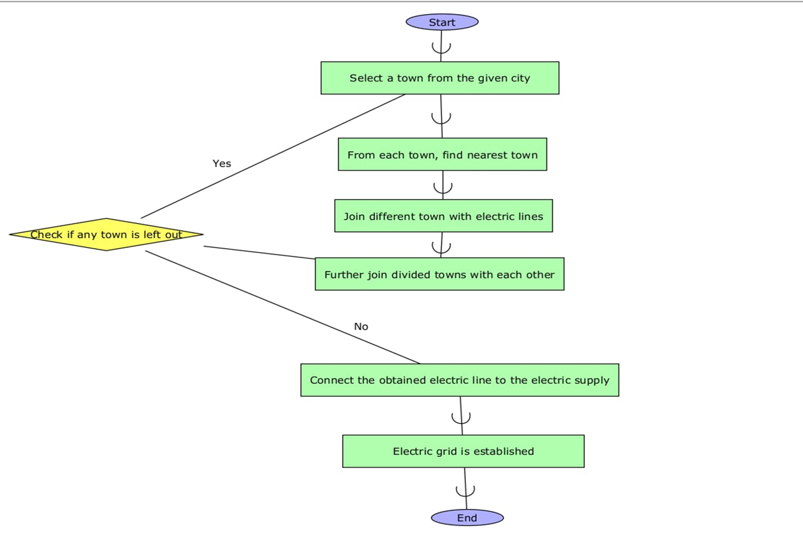
FLOWCHART

Slide 5
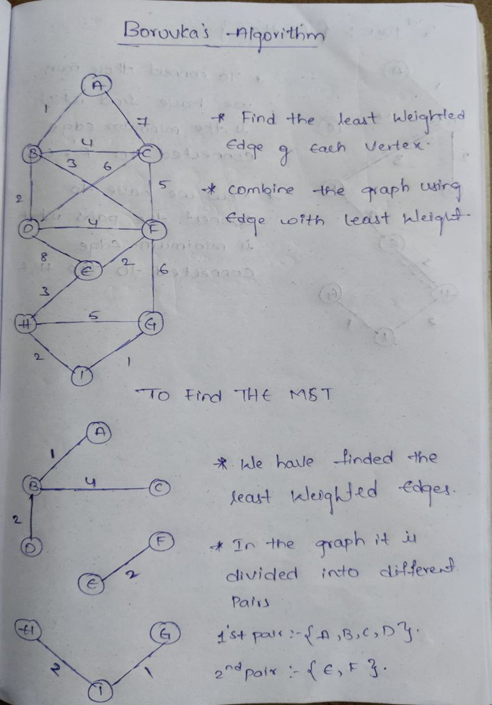
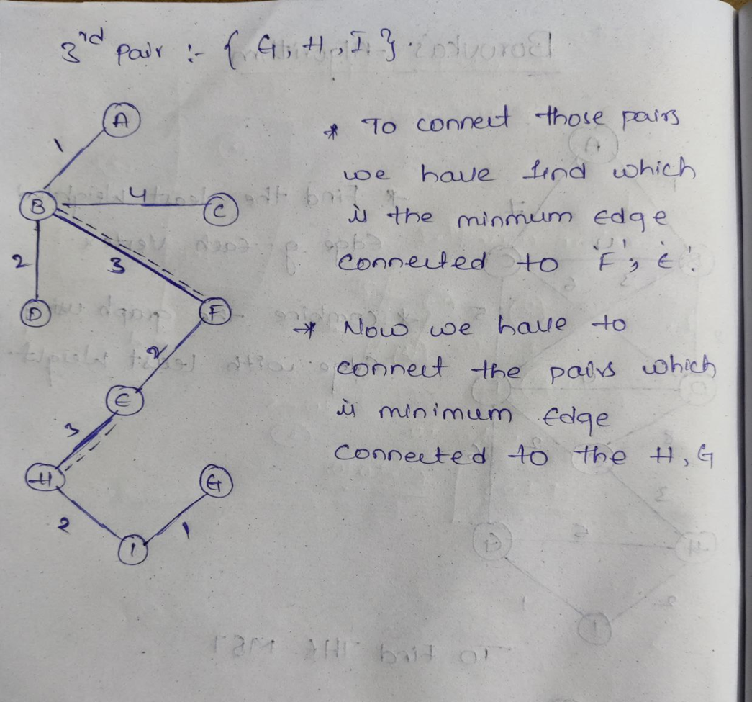
NUMERIC EXAMPLE OF THE ALGORITHM

Slide 6
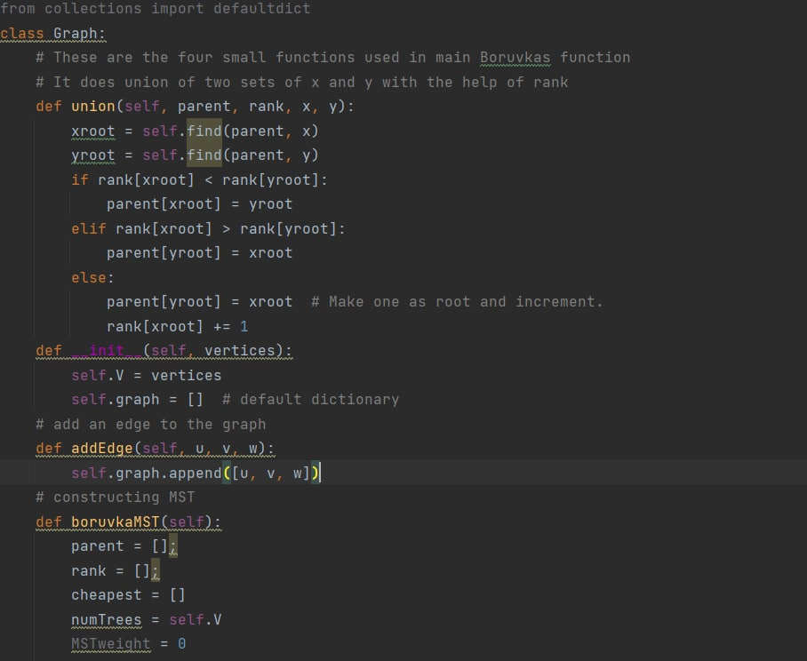
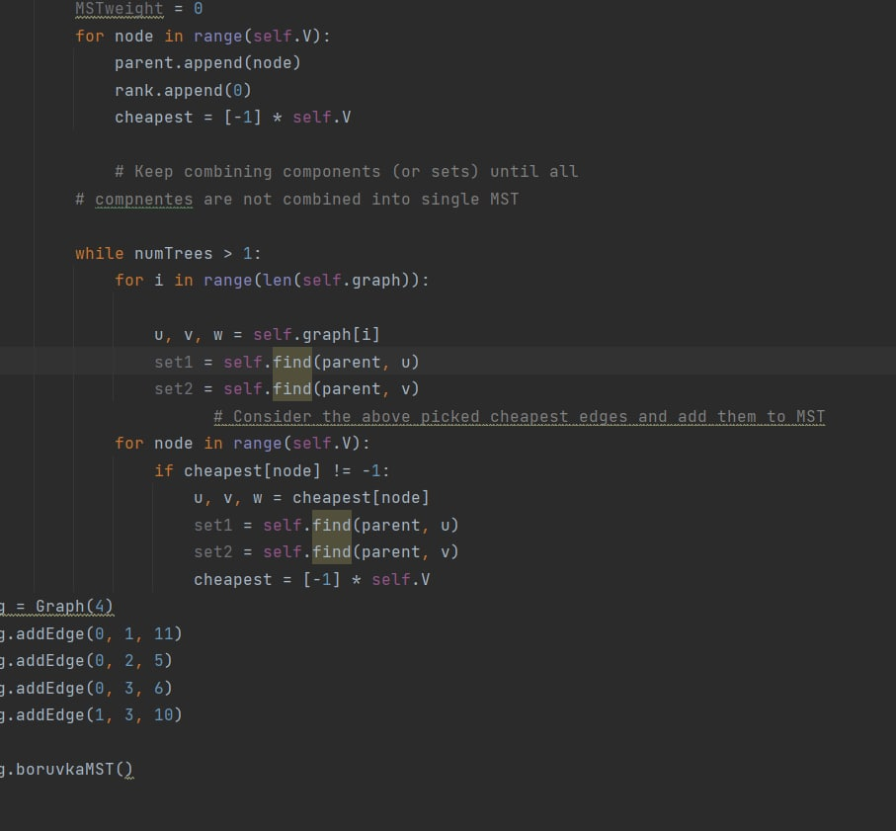
CODE

Slide 7
Github commits

Slide 8
Division of work

Slide 9
THANKYOU

